Slide 1

MPD Data Acquisition System:
Architecture and Solutions
Ilya Slepnev and VBLHEP DAQ Group
Joint Institute for Nuclear Research, RU
3 – 7 September
Warsaw

Slide 2
MPD DAQ
Intro
  System Requirements
  MPD DAQ Parameters
Readout Architecture
  Two Architectures
  WR Switch: VLANs, Priorities
  Readout Card Base Design
  Hardware Networking Stack
  Some of PCB Produced
Computing Architecture
  Data Processing Pipeline
  Distributed Event Building
  White Rabbit and Data Networks
  Data Network Topology
  Status of Online Cluster
Active Topics

Slide 3
MPD DAQ: System Requirements
Properties:
  Reliable data transfer
  Diagnostics. Data integrity check on all levels
  Fault tolerance and self recovery
  Distributed and scalable
Operation Modes:
  Multiple hardware trigger classes
  High Level Software Trigger: Off / Analysis / Filtering

Slide 4
MPD DAQ Parameters
Data
Acquisition
System
Control
Trigger
Timing
Raw Data
MPD Stage-1 DAQ parameters
Beam | Au-Au 9 GeV
Trigger rate | 7 kHz
Event size | 500 kBytes
Raw data rate | 3.5 GByte/s
Data taking time | 8 months / year
Beam available | 50% of time
Annual raw data size | 38 PB
Compression factor | 1:5 – 1:30
Annual storage size | 1 – 8 PB
Collision energy: 4 - 11 GeV
Beams: p to Au
Luminocity: 10²⁷ Au-Au

Slide 5
DAQ phase-space

Slide 6
MPD DAQ: Readout Architectures
Based on Common Readout Units
  Readout of TPC
  CRU is a link aggregator
  Timing, Trigger and Control by CRU
  Intelligence in CRU
Based on White Rabbit Network
  Readout of ECal, TOF, ZDC, etc.
  Intelligence in Readout Electronics
  Local Trigger and Control Units
  Scales well from 1 to 1000 boards
Take best of two for MPD
  WR based electronics performed great in BMN data taking run in March 2015
  Note: CRU and WR Core are not radiation hard and requires protection
  Both designs has much to implement yet to be ready for MPD run

Slide 7
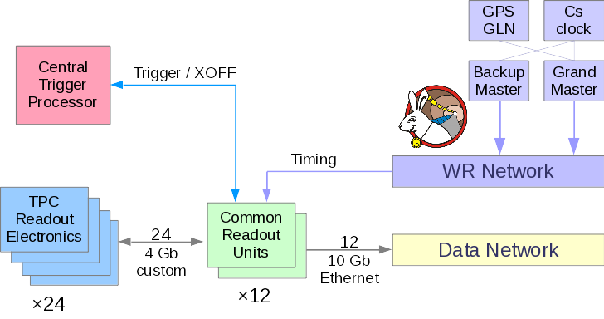
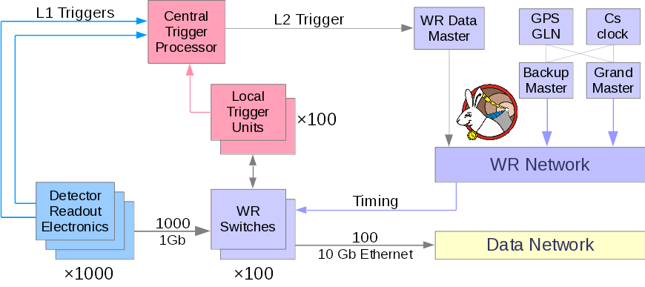
DAQ Architecture: Interconnects
Common Readout Units:
  Trigger, Timing, Control
  Data compression (clustering)
  Aggregate custom data links
  TCP-IP interface to DAQ
White Rabbit Network:
  All traffic on same network fibers
  Traffic at different priority levels
Readout electronics boards:
  Data compression
  TCP-IP interface to DAQ

Slide 8
DAQ Architecture: CRU based

Slide 9
DAQ Architecture: WR Network

Slide 10
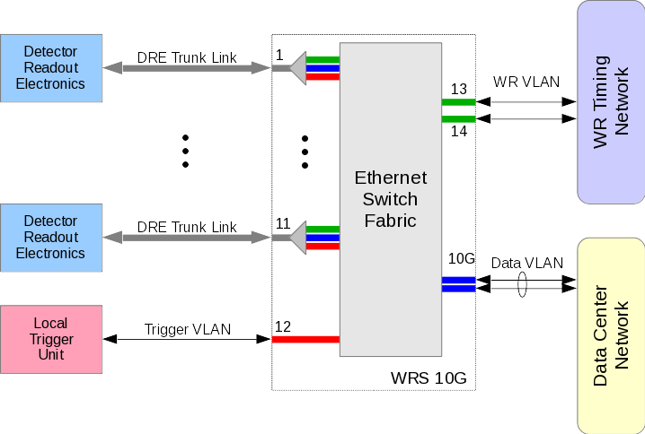
WR Network Streams

Slide 11
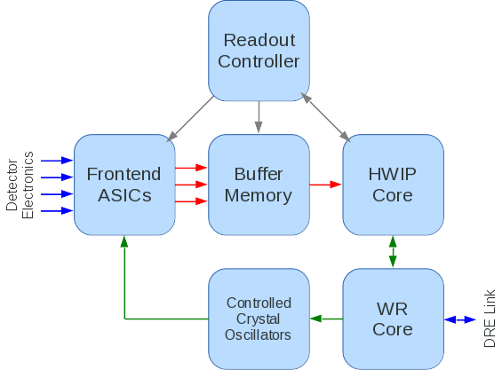
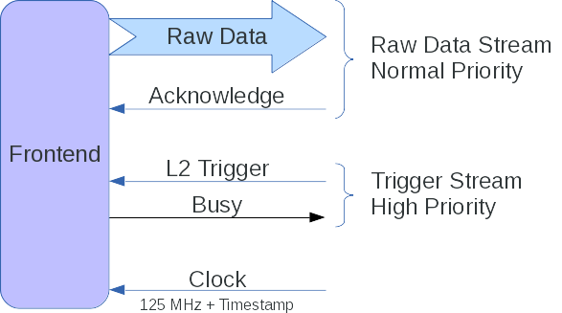
Detector Readout Electronics
DRE Board Structure
DRE Link Streams

Slide 12
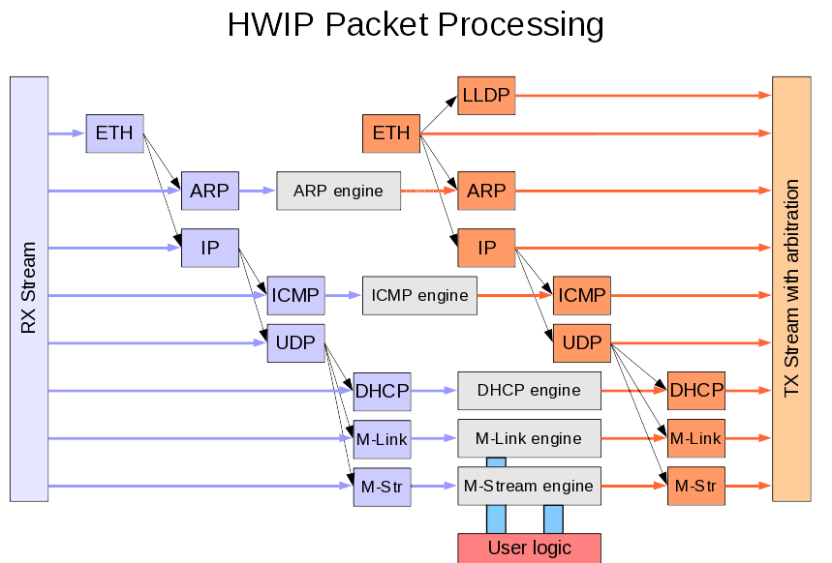
HWIP: IPv4 Network Stack on FPGA
IPv4 stack implemented on FPGA (10,000 lines in Verilog)
ARP, DHCP, ICMP, UDP, LLDP
M-Stream: reliable transfer protocol, FIFO streaming
M-Link: Register I/O protocol
Direct interface readout electronic board to computer cluster, no special drivers or interface cards required
Standards compliant
Works in pair with White Rabbit Node Core
Automatic Device Discovery

Slide 13
Some of MPD DAQ Electronics

Slide 14
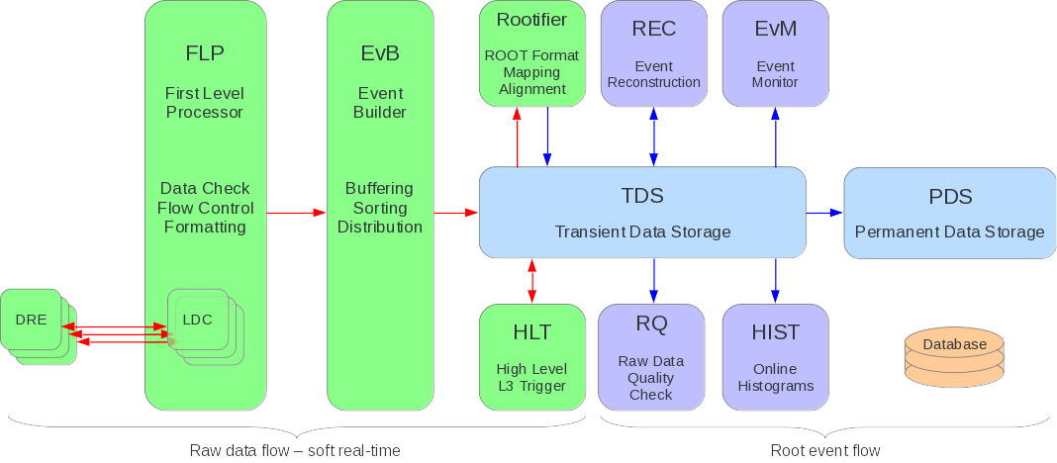
MPD DAQ: Computing Architecture

Slide 15
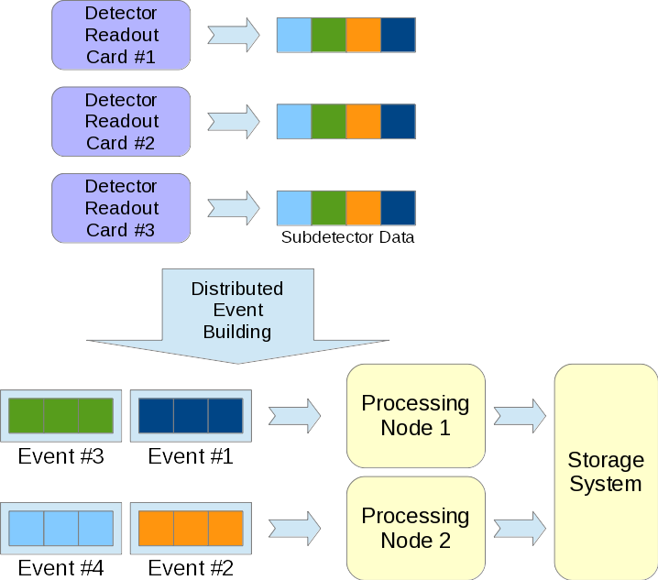
Event Building Data Flow
Distributed and Parallel data processing: MPD produces over 3 GBytes of raw data every second
Event Building – process of sorting data fragments from subdetectors and assembling complete event data ready for physical analysis
Reliability – handle single errors, data dropouts, corrupted data, timeouts, detector subsystem restarts or processing servers restarts without interruption of event building process
Integrity check over all data path. CRC insertion by readout cards

Slide 16
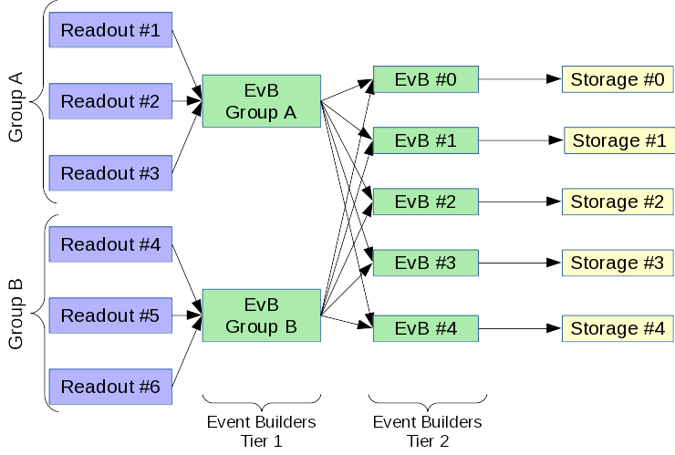
Distributed Event Building

Slide 17
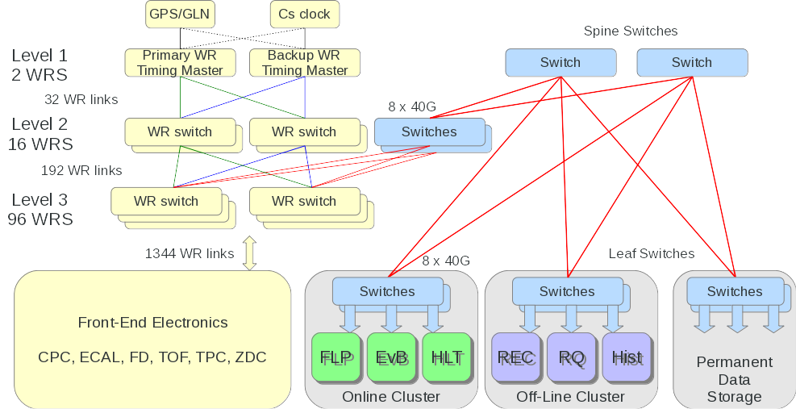
WR and Data Networks

Slide 18
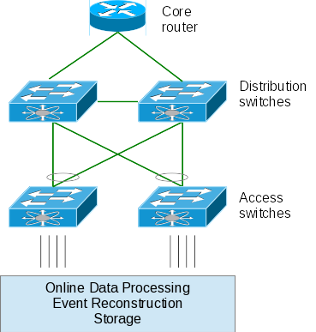
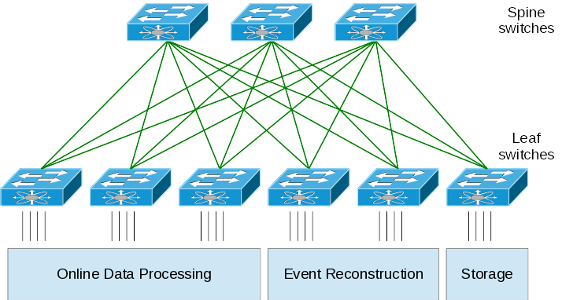
MPD DAQ: Network Topology
Upgrade
Topology: Core – Distribution – Access
Used by service providers
Bandwidth limited by distribution switches
Optimal for small number of links
Good for vertical traffic (client – server)
Small size DAQ – up to 40 Gb/s
Topology: Leaf – Spine (Clos)
Used in parallel applications / Big Data
Number of links defines bandwidth
Low and predictable latency
Good for horizontal traffic (cloud apps)
Multi-Terabit scale DAQ

Slide 19
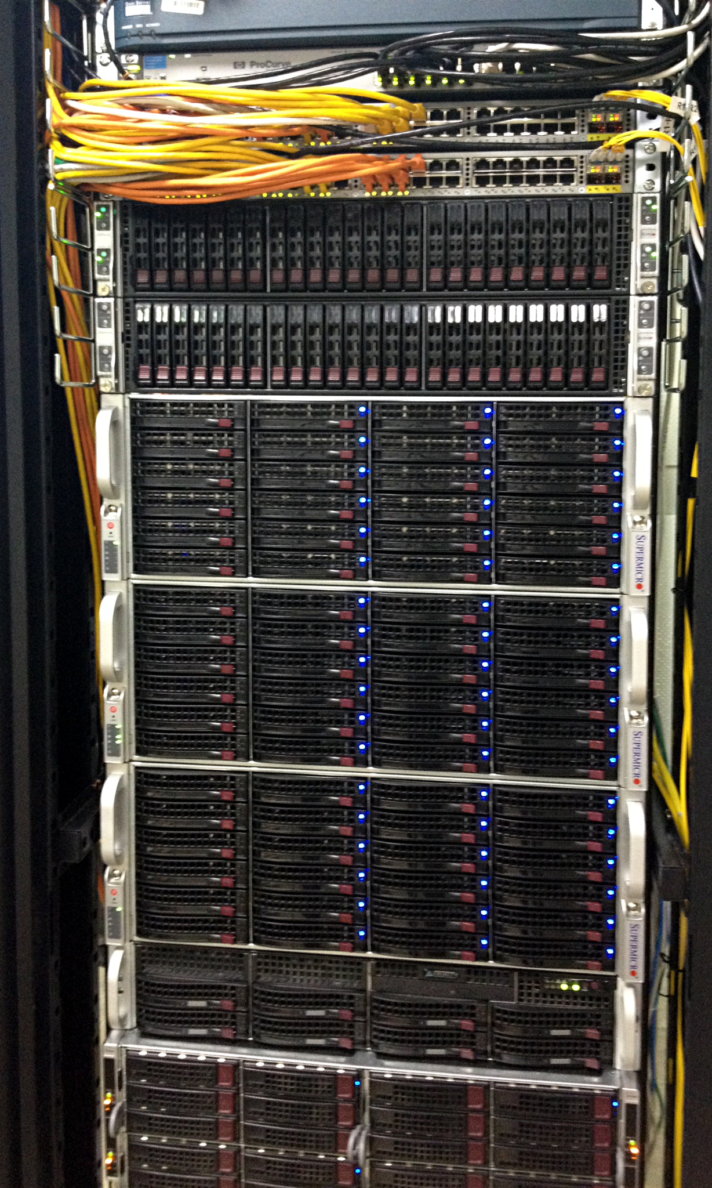
Online Computing Cluster in 2015
One rack put online for BMN run
8 Compute nodes in 4U
  160 x 3 GHz CPU cores
  1024 GB RAM
4 Storage nodes in 16U
  Ceph 0.94.3 “Hammer”
  Data on 4 TB HDD
  Journals on NVM-express SSD
  Triple replication
  430 TB raw, 144 TB usable
10GbE Network in another rack
  2 x Cisco Nexus 5548, High Availability pair
  2 x Cisco 4500X, VSS pair

Slide 20

Active Topics
DAQ Hardware
PCB Schematic and Routing
Assembly and Testing
Preparation for Installation
DAQ Computing
Distributed Processing
Detector Data Compression
Software Defined Storage
Cloud Networking
Database Programming
FPGA Engineering
Digital Signal Processing
Network Interfaces
Data Compression
Embedded CPUs

Slide 21
Thank You!

Slide 22
Extra slides

Slide 23
Summary
MPD DAQ: System Requirements
  Au+Au events, NICA
  DAQ phase-space
MPD DAQ: Readout Architectures
  DAQ Architecture: LRU based
  DAQ Architecture: WR Network
Detector Readout Electronics
  WR Network Streams
  Readout Electronics for MPD
  MPD DAQ: Data Flow
Computing Architecture
  WR and Data Networks
  Computing Cluster

Slide 24
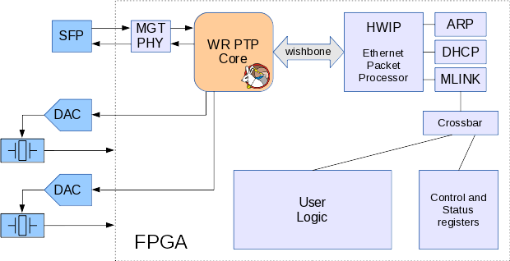
Readout Card: FPGA Connections

Slide 25
Au+Au events, NICA
Luminosity L = 10²⁷cm⁻²s⁻¹
Total inelastic cross-section σ = 6 b (6·10⁻²⁴cm²)
Event rate = 6 000 Hz (min. bias)
Multiplicity: central event n_{c} = 500, average n = 100
TPC average track size – 50 ionization centers (clusters)
One cluster induce signals on 6 pads
10 bytes per cluster (3 ADC samples + time + channel num.)
Min-bias TPC event size: 300 000 bytes.
ECal ~ 120 000 bytes. Others < 50 000 bytes.

Slide 26
References
NICA technical parameters
MPD CDR v1.4. JINR, 2013
MPD TDR (DAQ, TPC, TOF, ZDC). JINR, 2015
presentations:
Kevin Black, Trigger and Data Acquisition at the LHC. Harvard University
Niko Neufeld, High throughput DAQ. CERN, 23-29 October 2011

